Slide 1
Global mart week 3

Slide 2
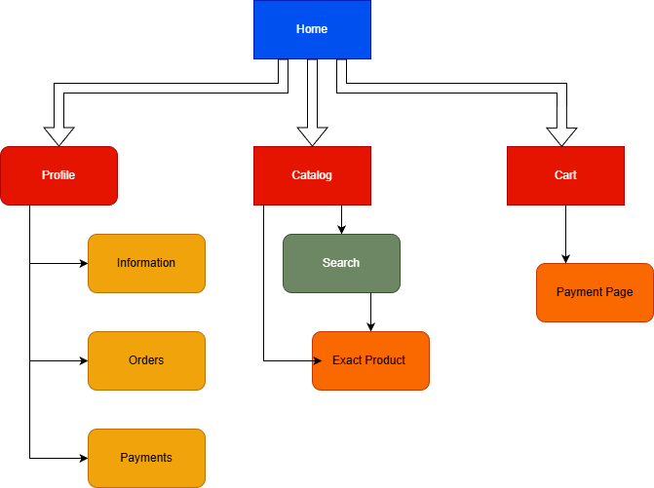
Making basic design(petr)

Slide 3
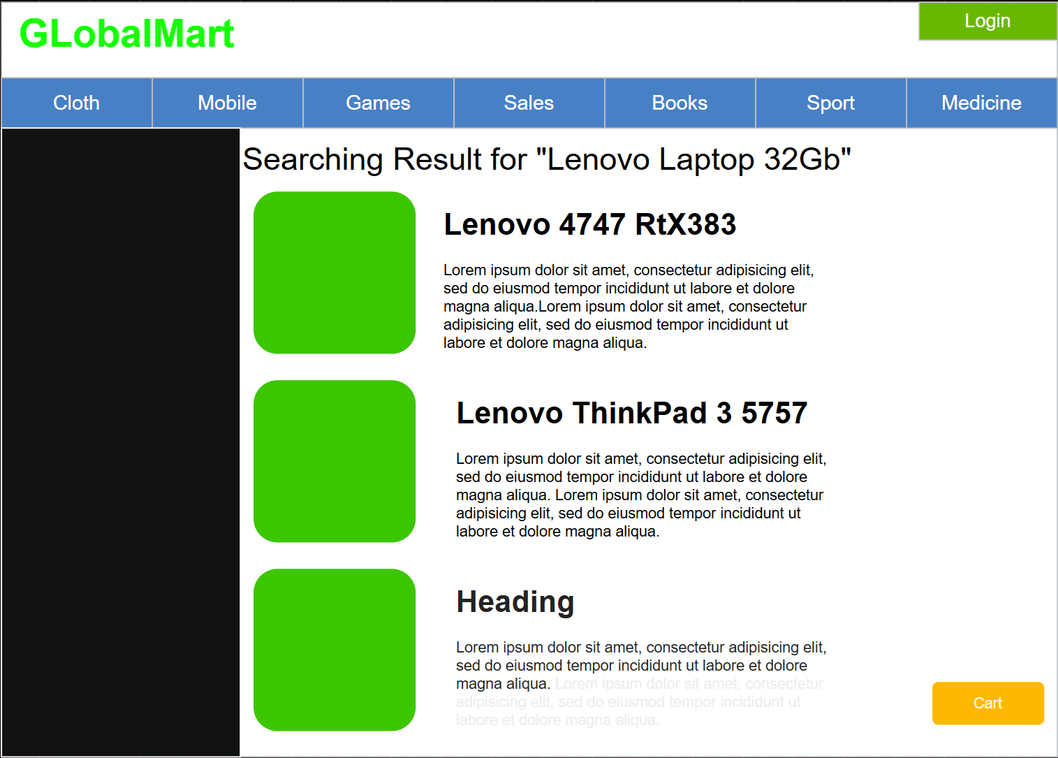
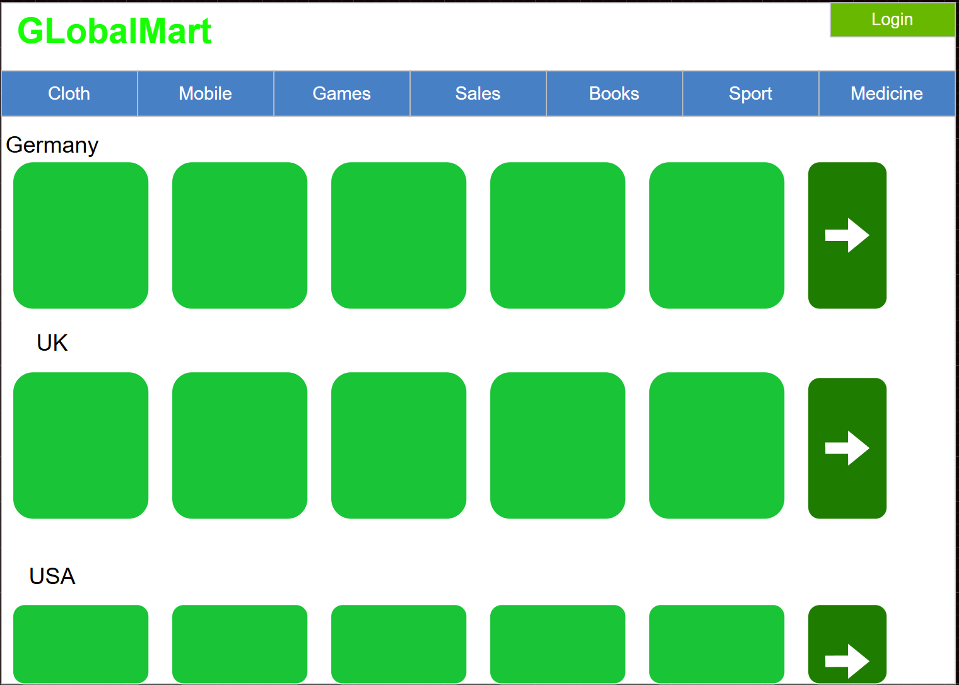

Slide 4
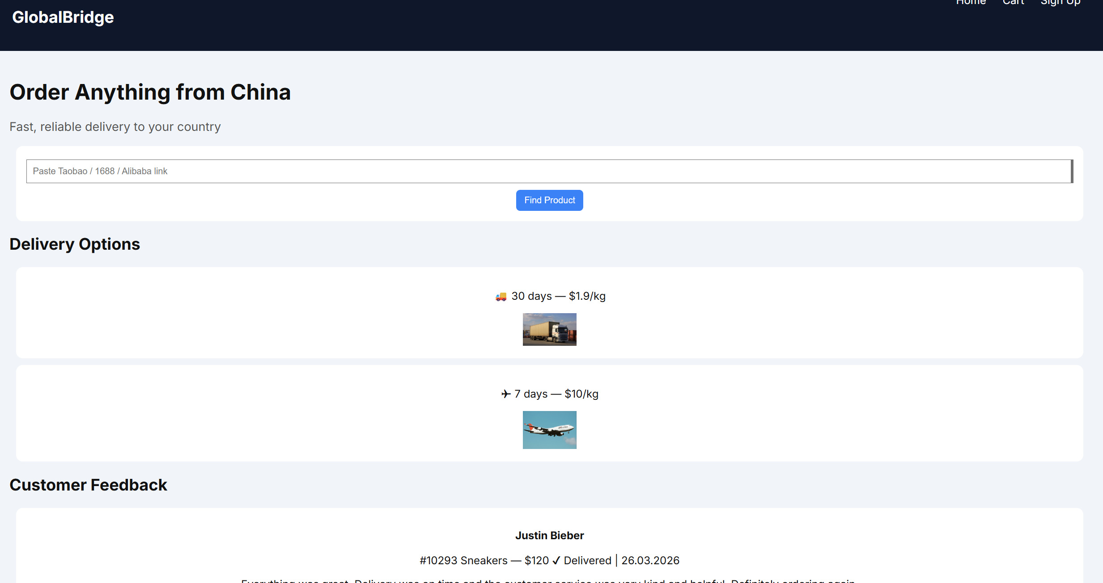
Making website prototype

Slide 5
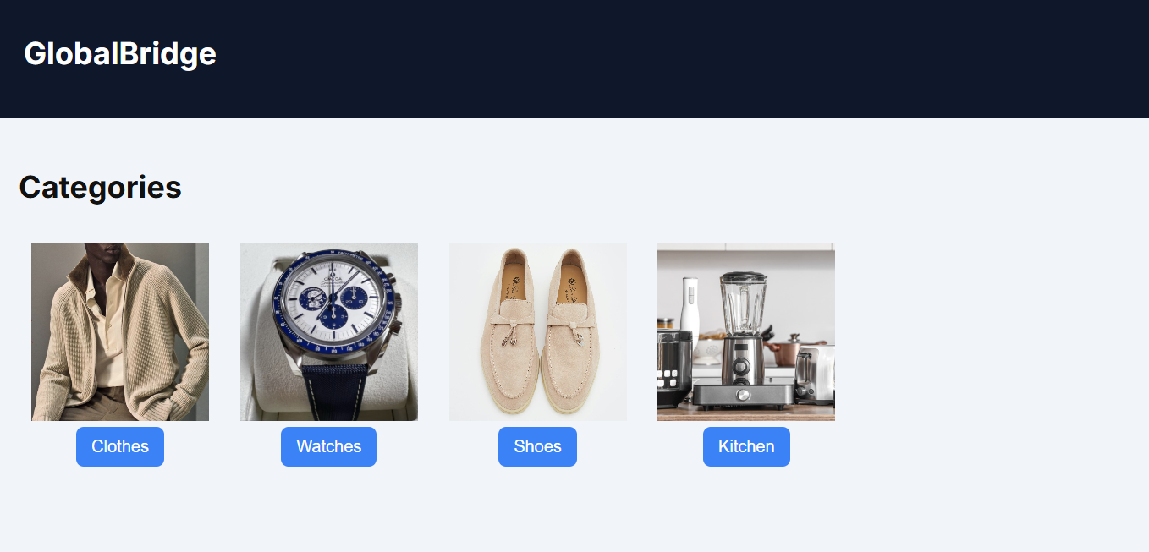
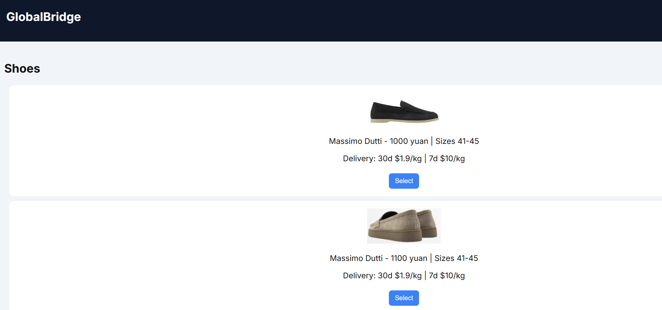

Slide 6
Plans for next week
Server
Website Version 2.0

Slide 7
Thank you

